Slide 1
Tasks
Gastón Landeira - 238473
Matías González - 219329
Iñaki Etchegaray - 241072

Slide 2
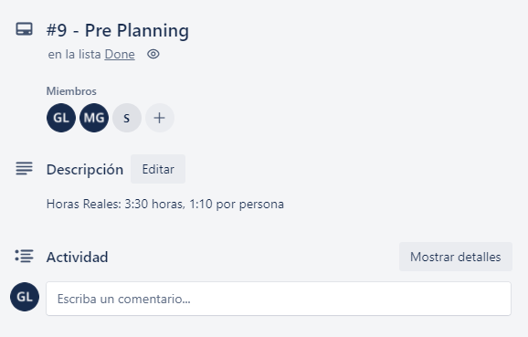
Task

Slide 3
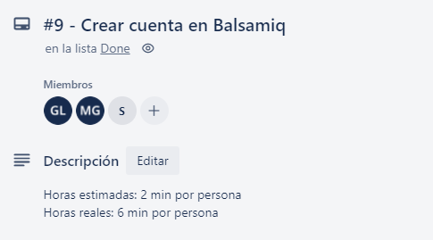
Task

Slide 4
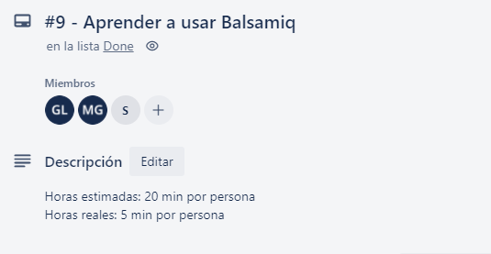
Task

